Slide 1
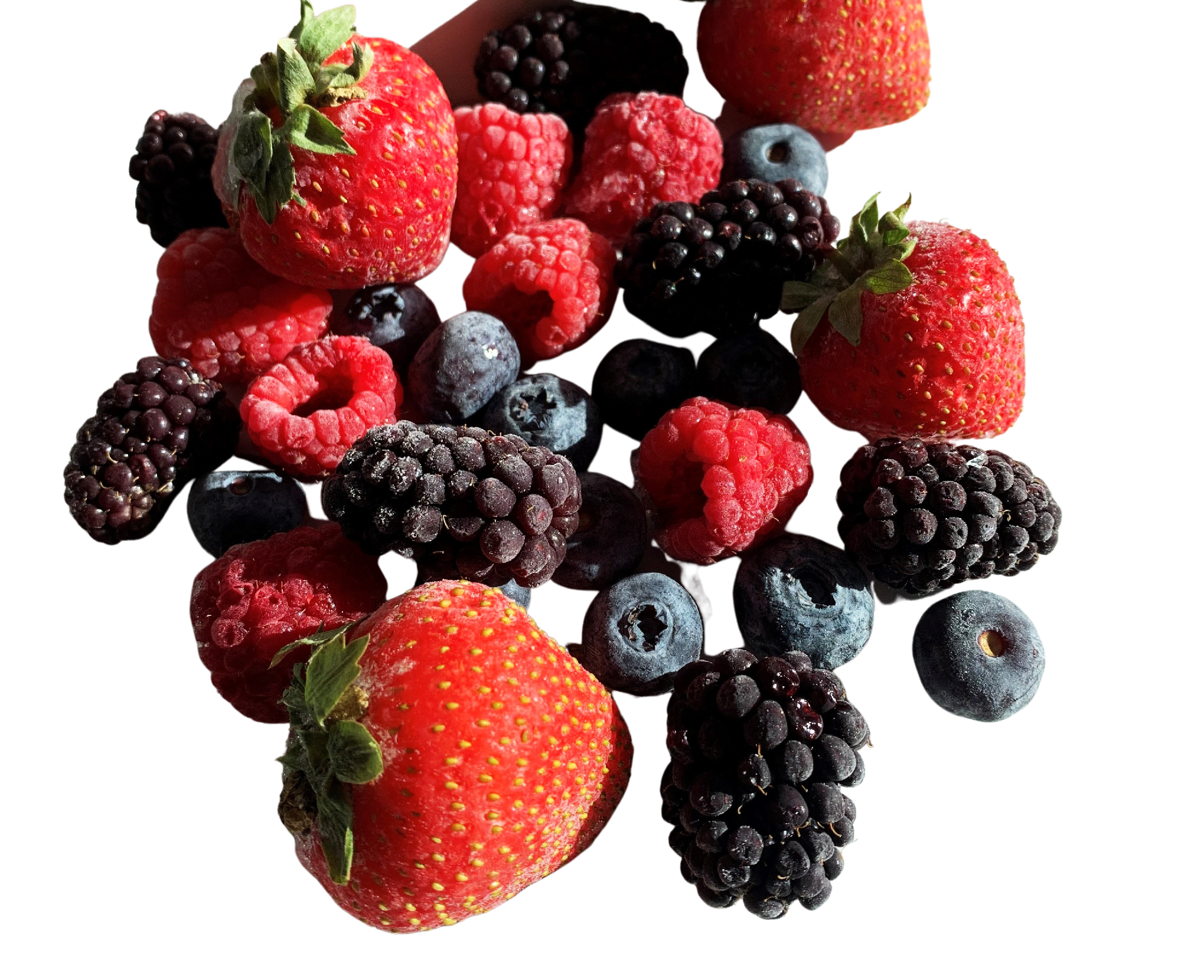
Over 17% OF THE FOOD PRODUCED EACH YEAR IS WASTED
*According to a United Nation Report
Next
Notes:
Report: https://www.un.org/en/observances/end-food-waste-day

Slide 2
UPCYCLED
BEAUTY
High-performance ingredients with a higher purpose
Next
Notes:
Brief introduction of speaker & company.
General source: https://www.globenewswire.com/en/news-release/2022/06/24/2468914/0/en/Intensifying-Awareness-and-Usage-in-Cosmetic-Industry-will-strengthen-the-Demand-of-Upcycled-Ingredients-States-Fact-MR.html

Slide 3
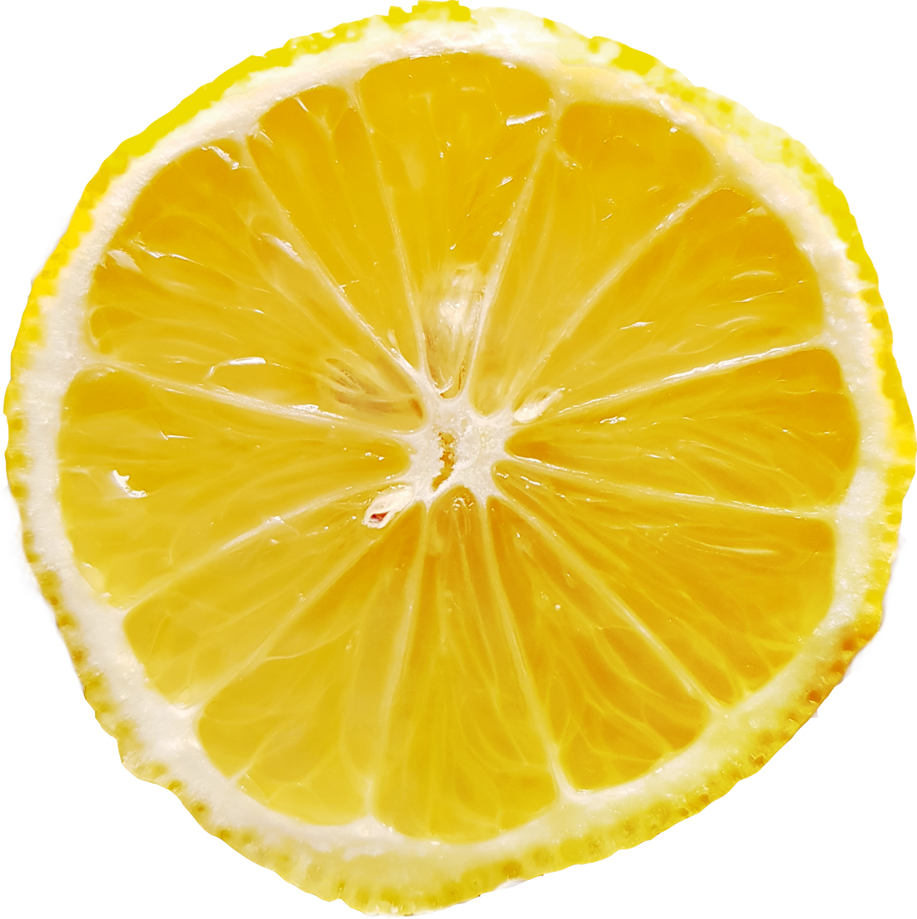
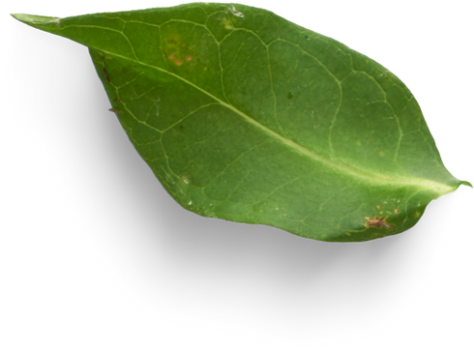
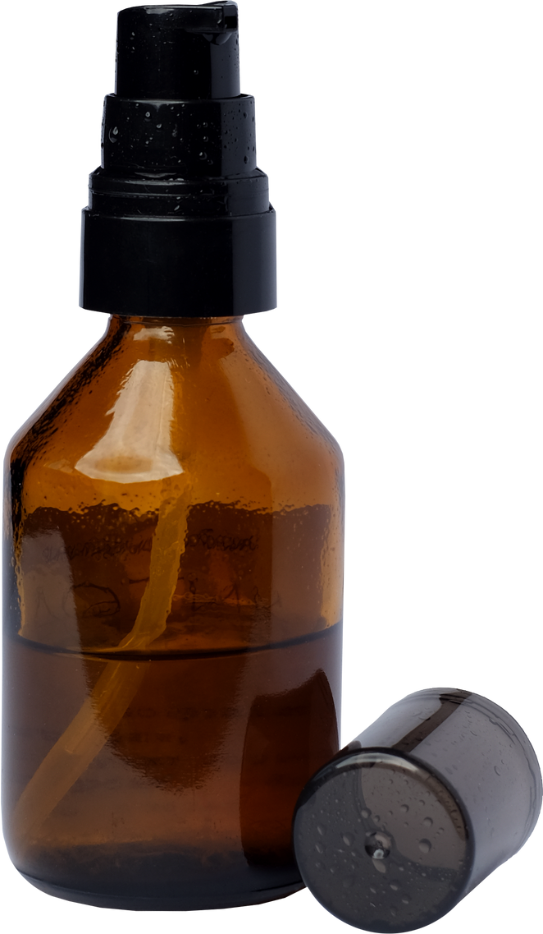
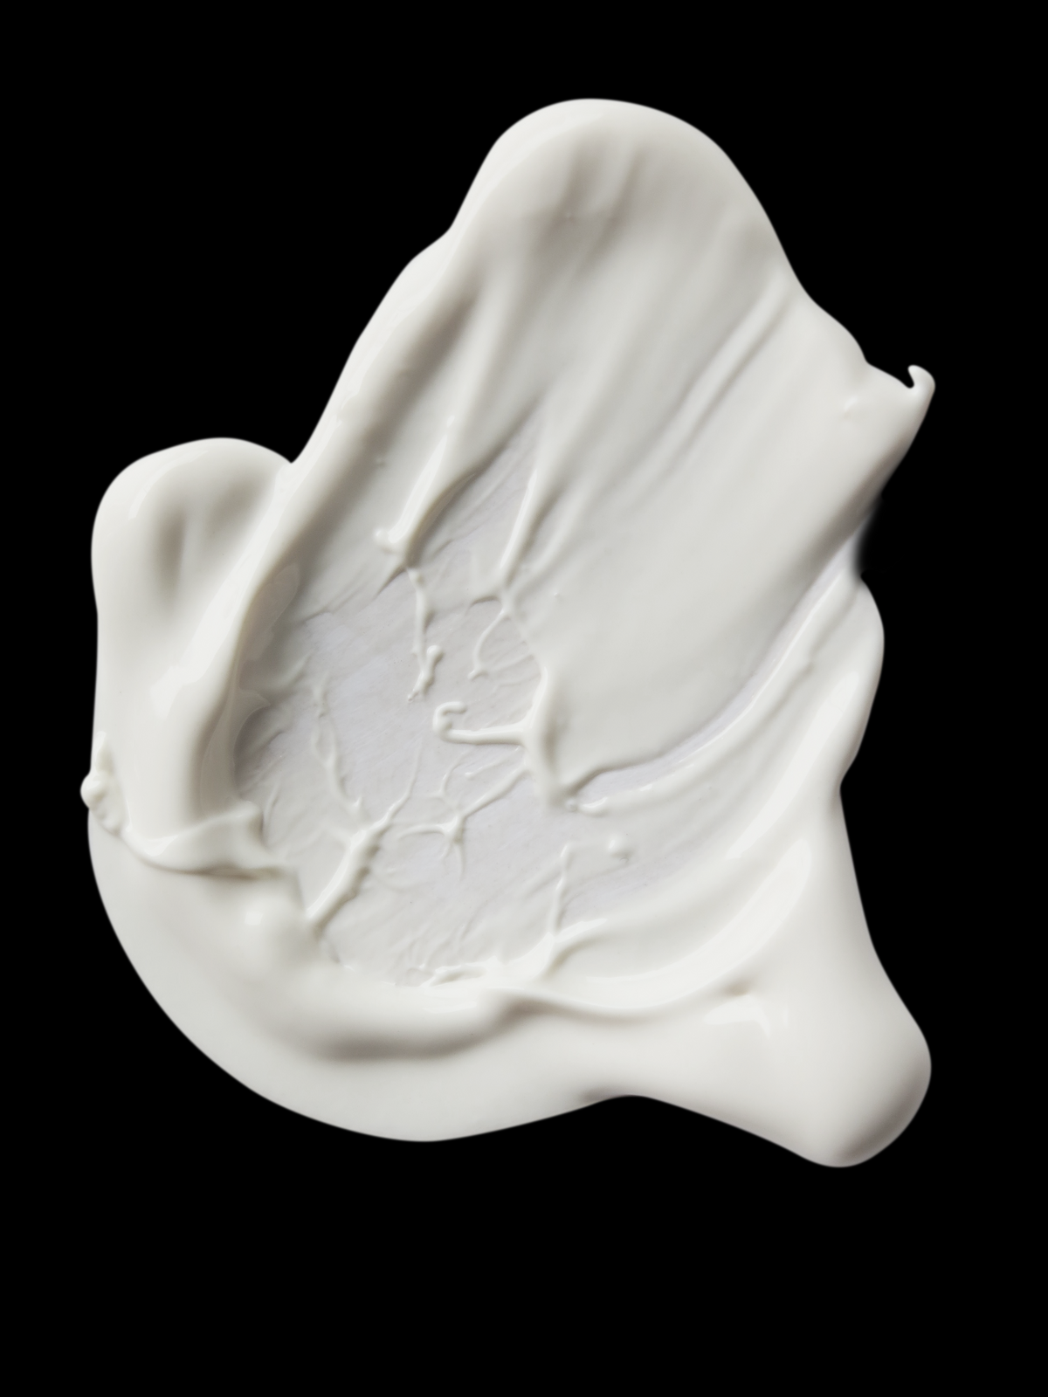
Visit our new website www.ctc.ca
Upcycled Beauty
is
a new economic model
a trend
a movement
Next
Notes:
See resource: https://www.cosmeticsandtoiletries.com/research/consumers-market/article/21836438/sophim-upcycling-a-midterm-trend-or-a-new-economic-model

Slide 4
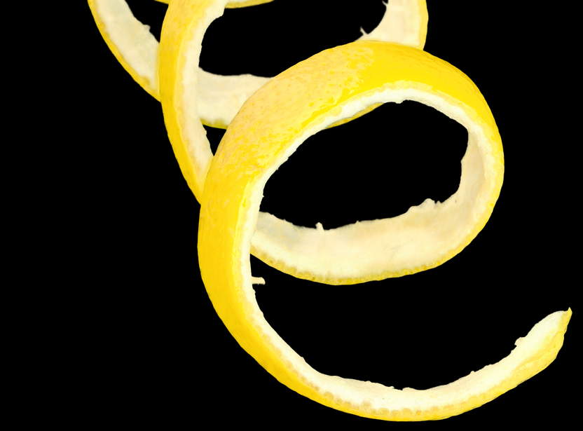
Visit our new website www.ctc.ca
WHAT IS
Upcycled Beauty?
Upcycled beauty describes beauty products made with or made entirely from by-products or 'waste’ from the food industry.
This movement offers forward-thinking brands an opportunity to create innovative beauty products that make better use of the precious resources around us -without compromising quality or efficacy.
Previous
Next

Slide 5
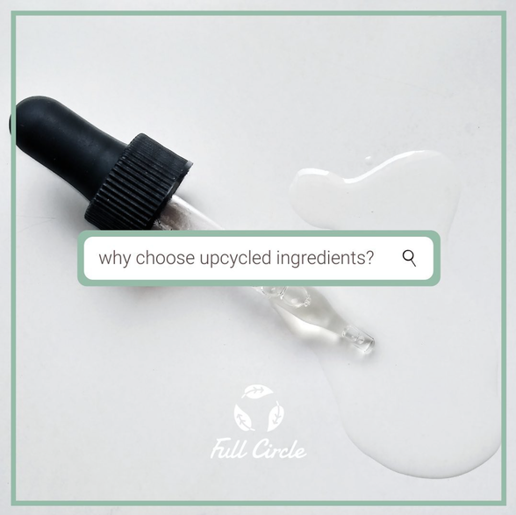
Visit our new website www.ctc.ca
GIVE THE CONSUMER
WHAT THEY WANT
97%
of consumers want beauty brands to be more transparent about the ingredients in their products.
1
Why choose upcycled ingredients?
Over 1/3
2
of consumers chose beauty & personal care brands that have environmentally sustainable practices & values.
Previous
Next
Cosmetics Business, 2020, Nearly 100% of consumers call for an end to beauty ingredient jargon
SGK, accessed 01/2023, 5 ways brands can make consumers greener
Notes:
The negative impact of food waste on the environment has escalated social concerns regarding food waste management, which has opened the door for upcycled ingredient manufacturers.

Slide 6
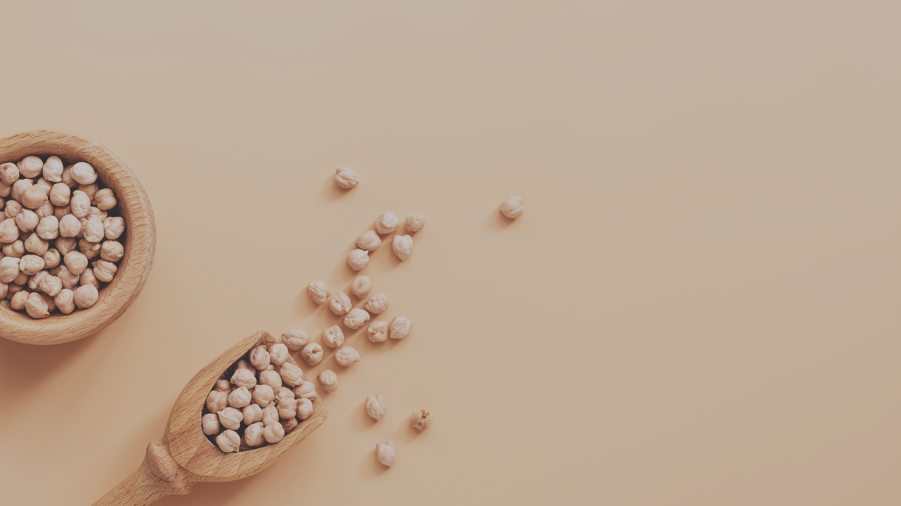
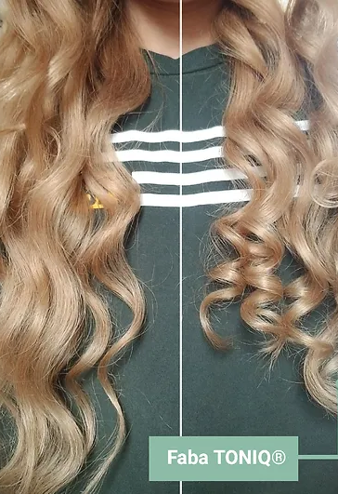
Visit our new website www.ctc.ca
Chickpeas are not only for hummus
They're also incredible for the hair
Faba TONIQ®
Upcycled hair styling active
Natural, upcycled hair styling active for defined, long-lasting curls.
Previous
Next

Slide 7
Visit our new website www.ctc.ca
Chickpeas are not only for hummus
They're also incredible for the hair
Previous
Next

Slide 8
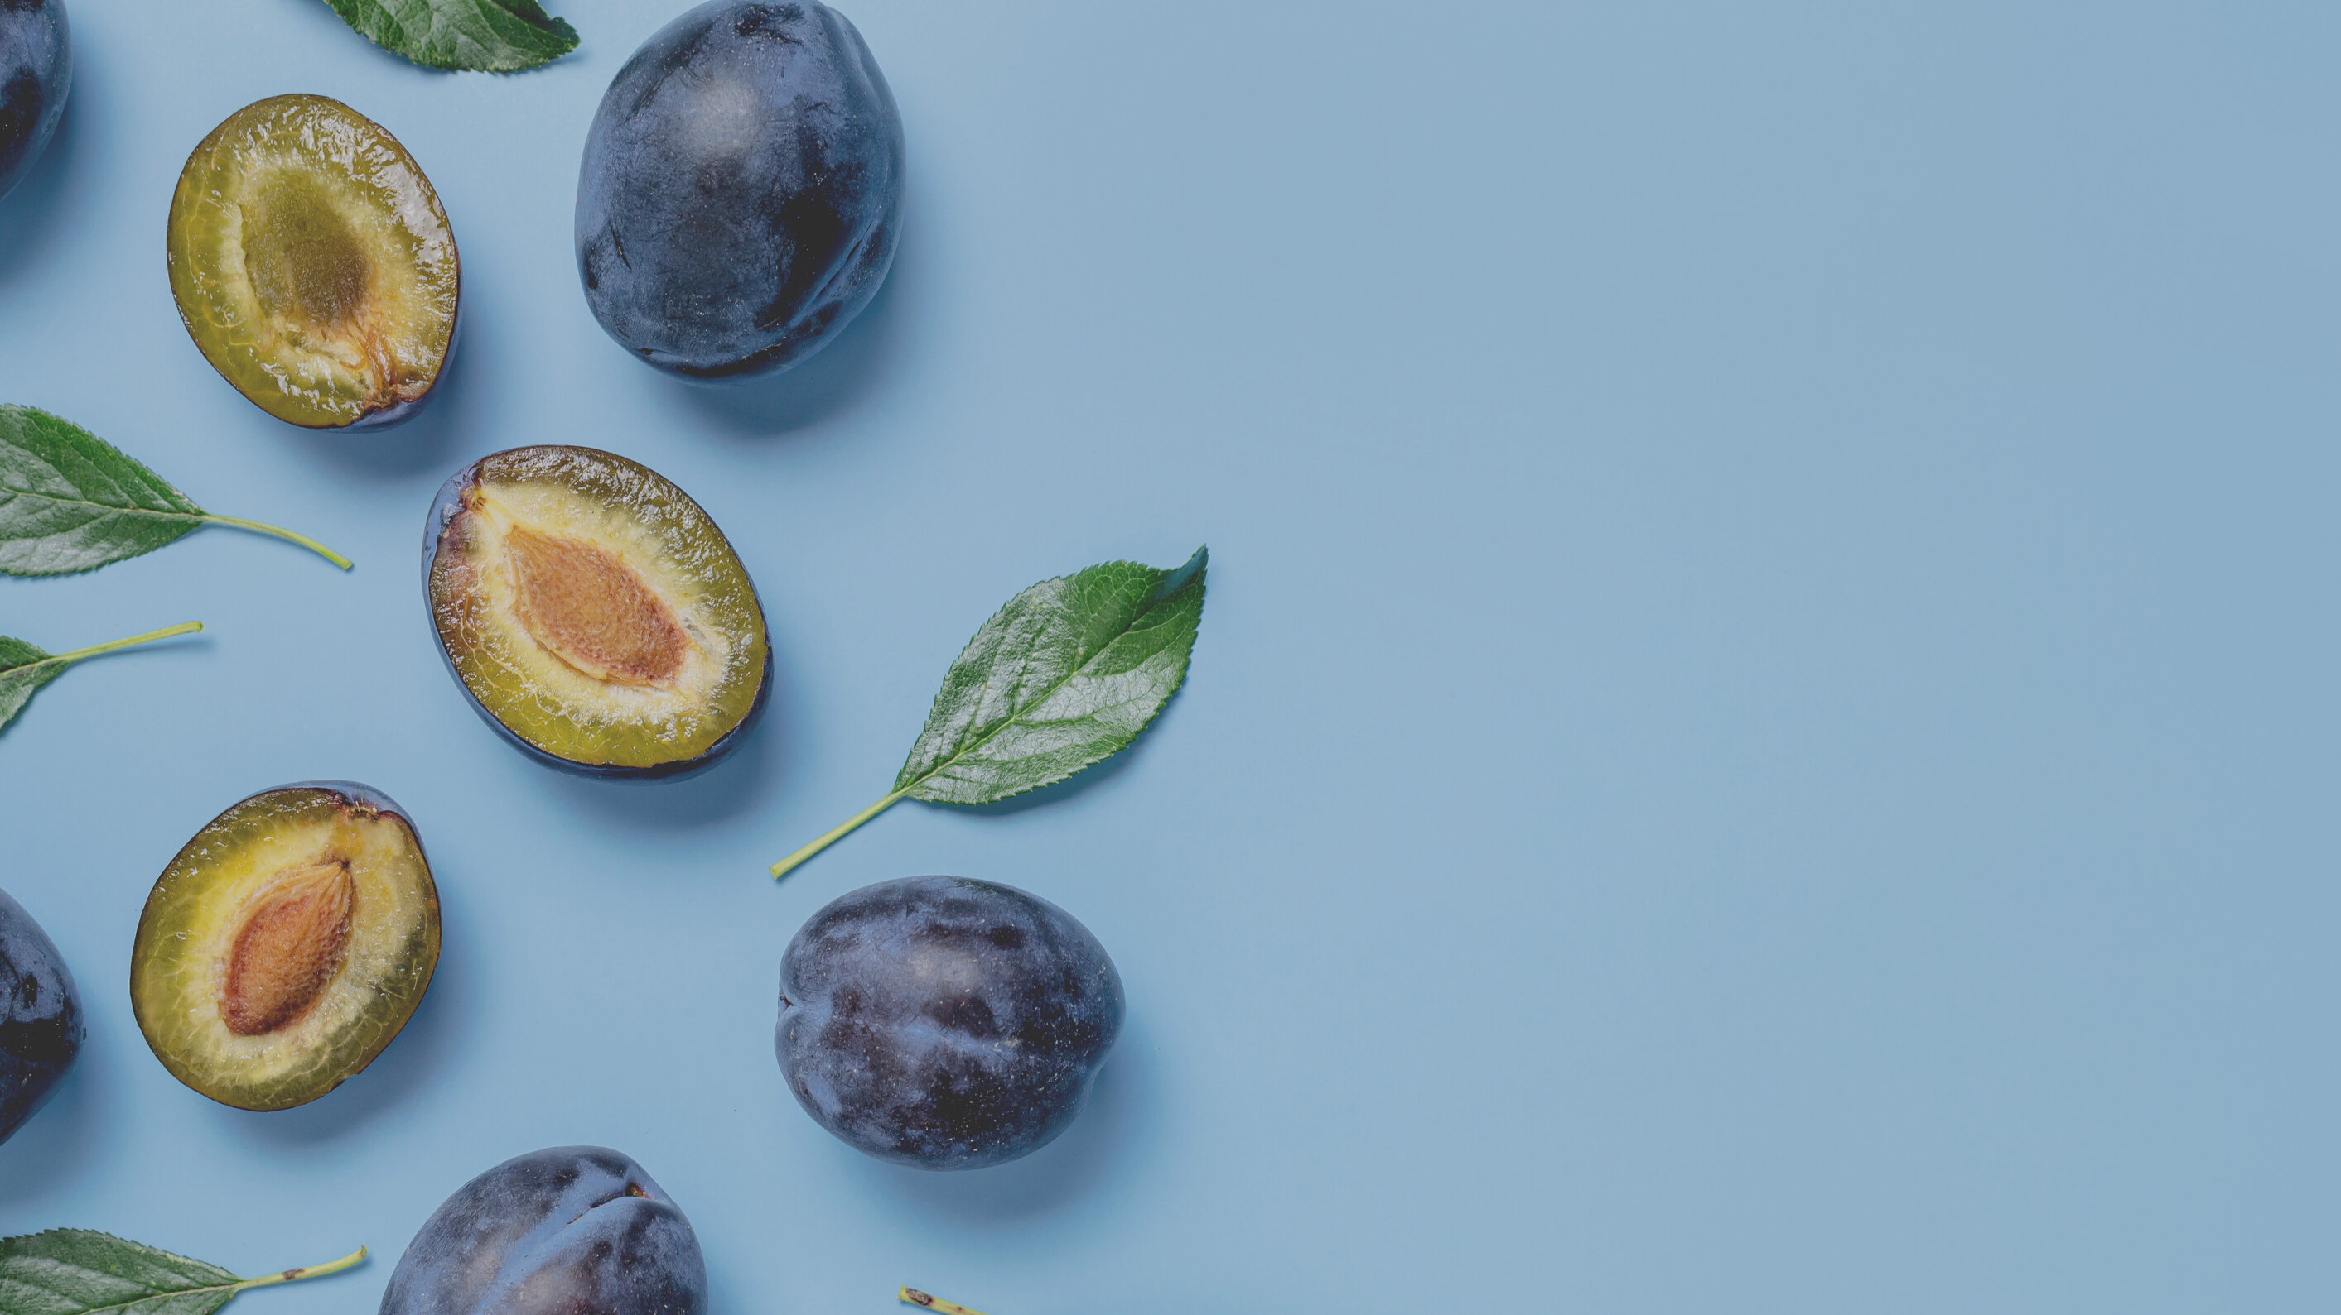
Visit our new website www.ctc.ca
Plums are not just for pies
They’re also incredible for the skin
VIRGIN PLUM OIL
Upcycled moisturizing oil
Naturally rich in Omega 6 and 9 fatty acids, this oil offers a pleasant almond aroma which makes it the perfect base odor mask for fragrance free products.
Previous
Next
Notes:
All natural formulations can be great but something that puts off a lot of consumers is the smell of those natural formulations. This moisturizing oil is naturally rich in Omega 6 and 9 fatty acids AND offers a pleasant almond aroma. This makes it the perfect base odor mask for fragrance free products

Slide 9
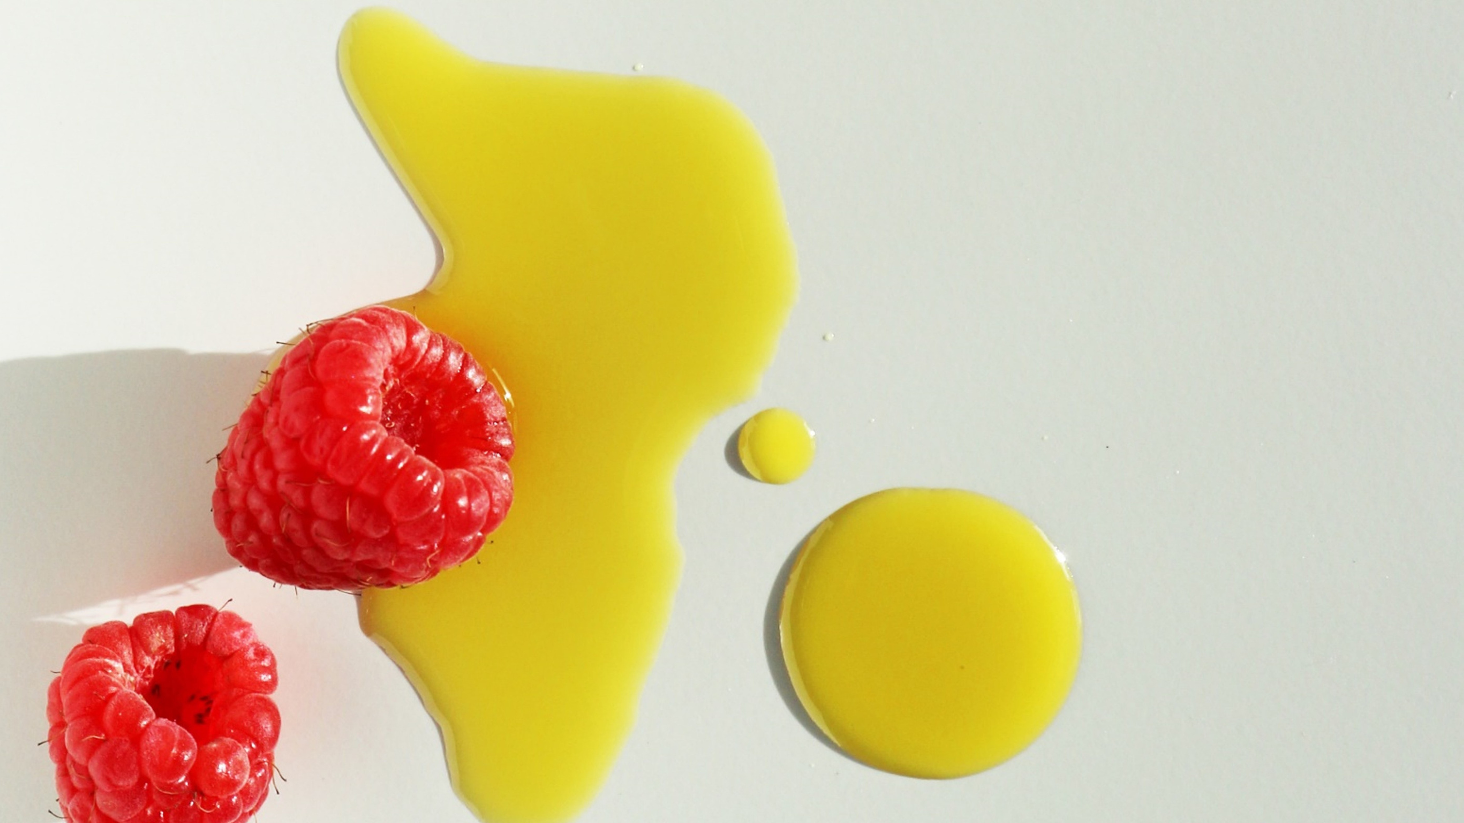
Visit our new website www.ctc.ca
Thank you,
Come talk to us.
Let's discuss sustainability, innovation & more.
Previous
Next
Notes:
Receive the 2022 waste report for free.

