Slide 1
8 Things You Should Know About Applied Research at Seneca Polytechnic
Ira Sherr
Manager, Seneca Centre for Innovation in Life Sciences (SCILS)
ira.sherr@senecacollege.ca

Slide 2
1. SCILS helps SMEs develop early-stage IP
Seneca Centre for Innovation in Life Sciences
Supports product development, enhancement and validation in the life science and cosmetic science sectors
We make no claims to IP developed in projects

Slide 3
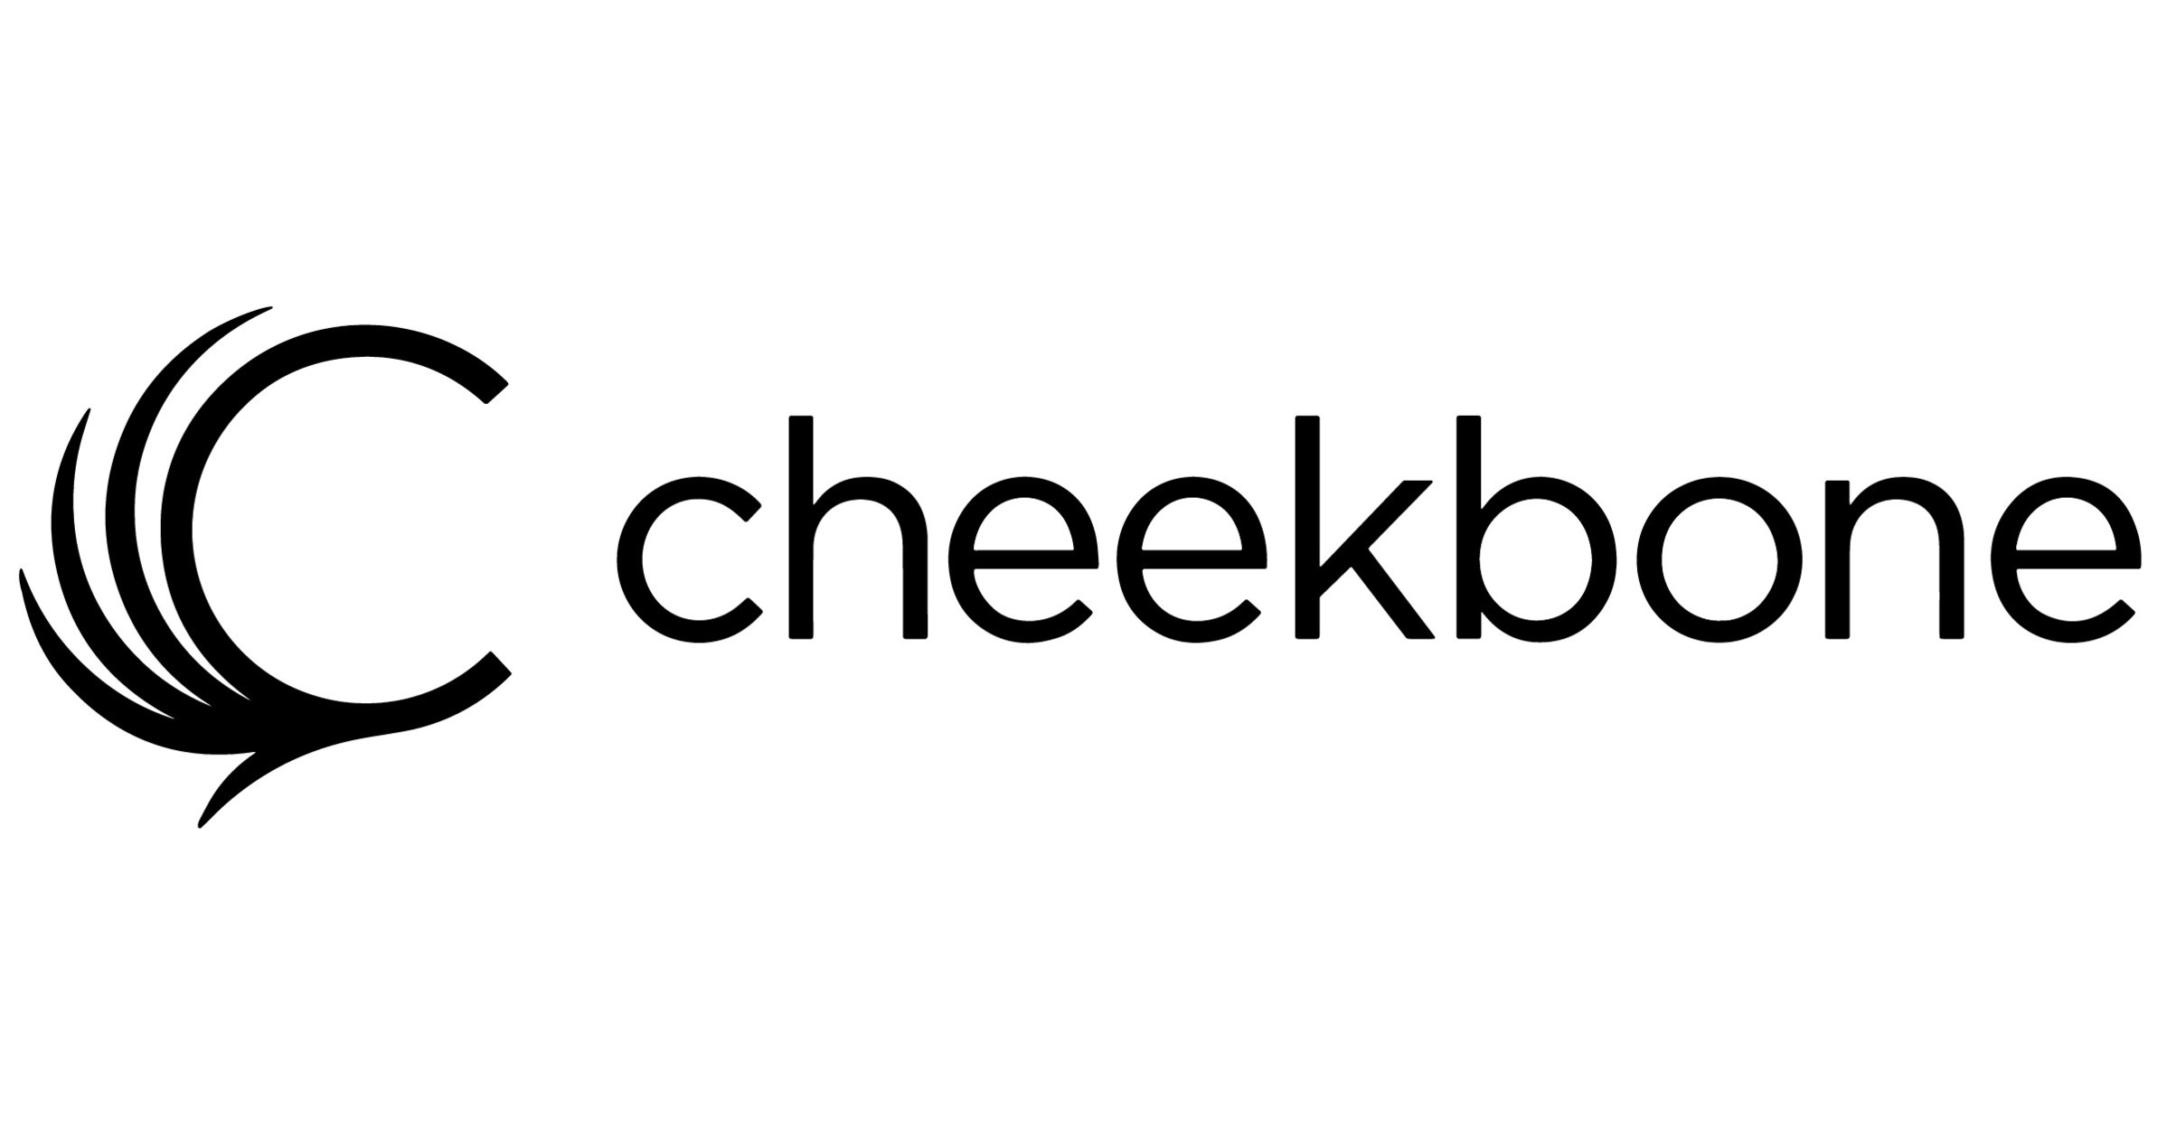
2. We work with companies across life and cosmetics sciences
Capabilities:
Assay development and validation
Product development and formulation
Method development and process optimization
Product stability enhancement and testing
Quality control and regulatory affairs
Research Interests:
Cosmetics formulations, immuno/molecular diagnostics development, analytical chemistry, materials chemistry, molecular biology, microbiology, protein biochemistry, genetic engineering, synthetic biology…

Slide 4
3. Our grant covers 70% of project costs
We have ready-to-deploy NSERC funding
Requires partners have 2+ full-time employees
Partner cash contributions are just 30%

Slide 5
4. We pair industry-trained faculty with our best students for impactful research projects
Applied Research Summary, 2022-2023
$4,919,533
research funding
38
STUDENT Research Assistants
63
APPLIED RESEARCH projects
36
FACULTY Investigators

Slide 6
5. We’re building a cutting-edge applied research lab to serve our partners
3000 sq. ft. cGMP-like space Biosafety Level 2

Slide 7
6. We’re always looking to help new partners
Mandated to help Ontario SMEs (<500 employees)
Require a minimum of 2+ FTE
Interested in learning about your R&D obstacles
Equipment access?
Tests to be performed?
Lab access?
Need subject matter experts?

Slide 8
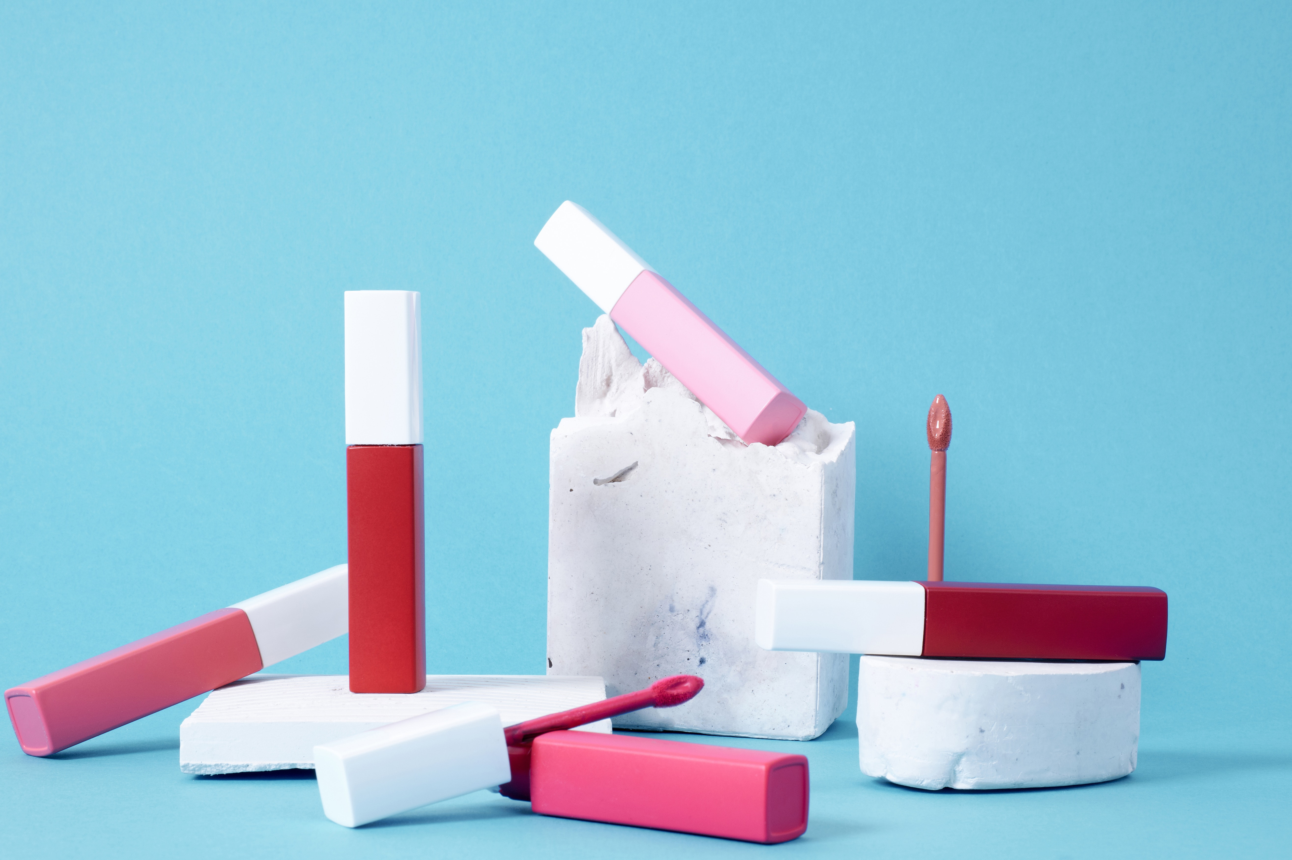
7. We have the only post-graduate Cosmetics Sciences program in Canada
Laboratory-based, one-year graduate certificate program
Students learn to formulate skin care and colour cosmetics for global markets, along with testing for safety and efficacy
Strong focus on product formulation, cosmetic production and the industry's evolving regulatory industry, including product development processes, global regulations/challenges, biological systems, sales and marketing.
The optional Work Integrated Learning (WIL) term helps students to get industry experience and apply that to their second academic semester

Slide 9
8. Our Cosmetics Science capstone projects are perfect for startups
Teams of students design all aspects of a new product over 14-week timeline, working with partner based on marketing brief
Students formulate the product, design marketing strategy, design and order packaging, check stability, author SOPs, and check regulatory requirements for relevant markets
The students present their project to a panel of industry judges, who give them feedback on their completed project. Students also receive valuable feedback from the partner
Very small cost for entire development pipeline; no company size limits

Slide 10
Get in touch!
1. Google “Seneca SCILS” → “Partner with Us”
2. ira.sherr@senecacollege.ca
3. Cosmetics Science program or projects:
sonal.kamath@senecacollege.ca
Questions?

