Slide 1
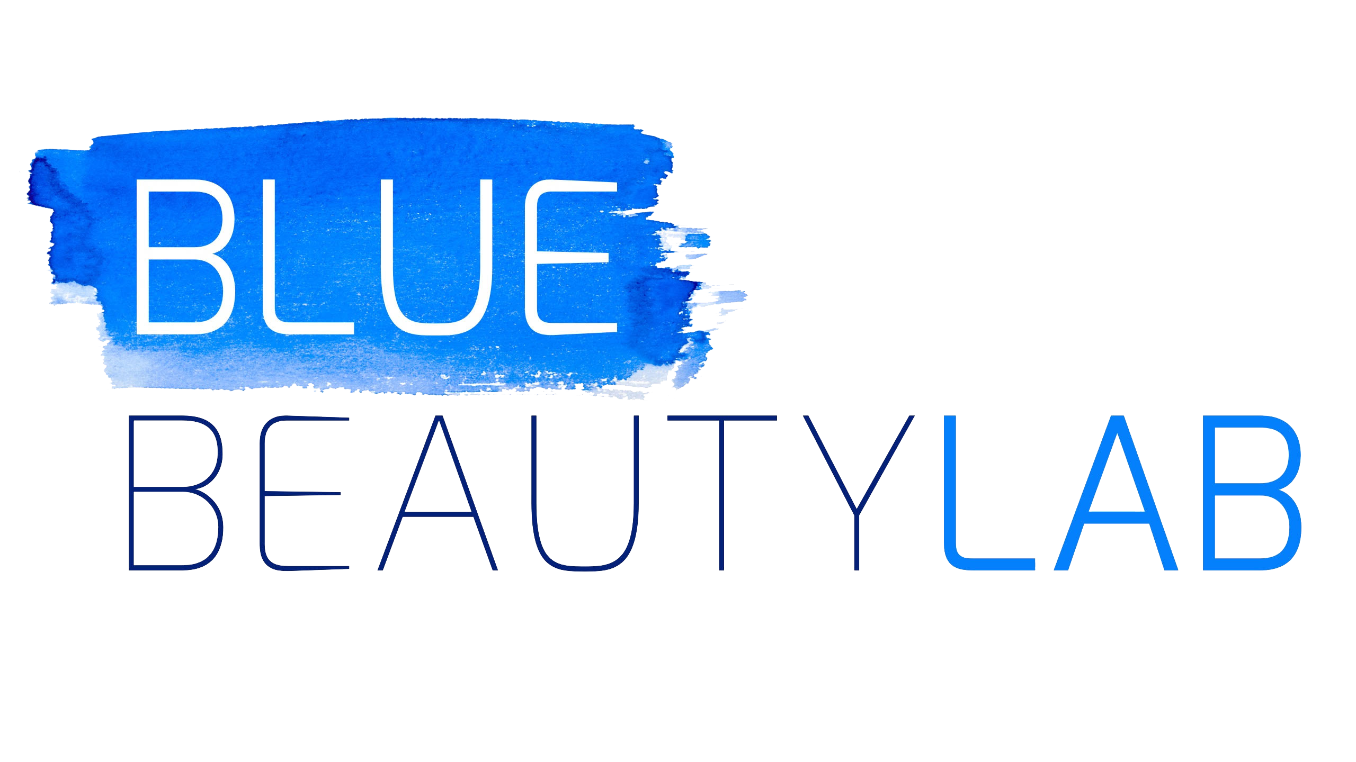
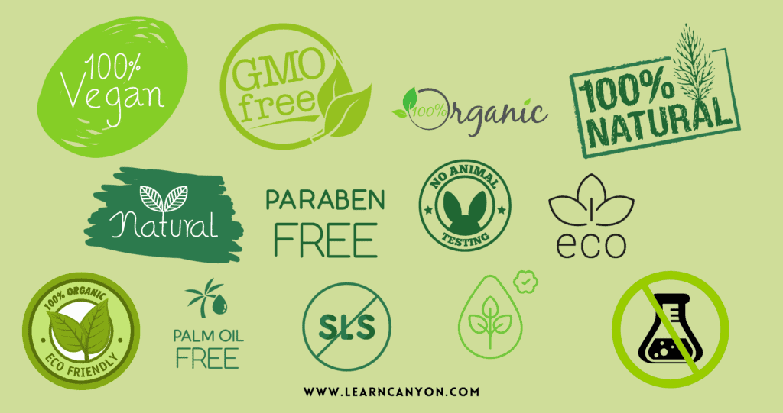
TOP 5 BEAUTY TRENDS HOW DO THESE TRENDS AFFECT FORMULATORS & PRODUCT DEVELOPMENT?
Clean beauty: The clean beauty movement continues to gain momentum, with a focus on products that are free from harmful chemicals, toxins, and potentially irritating ingredients. Consumers are increasingly demanding transparency in sourcing & manufacturing practices.
Need regulatory definition of “clean” and to educate consumers that “clean”, natural & organic ≠ doesn't always equate to sustainable
Majority of the innovative clean & sustainable beauty technologies are still coming from EU. We don’t have enough volume to bring the costs down and make ”clean” & sustainable products accessible and affordable for larger distribution.
North America is starting to catch-up, but we are still highly dependent on imports

Slide 2
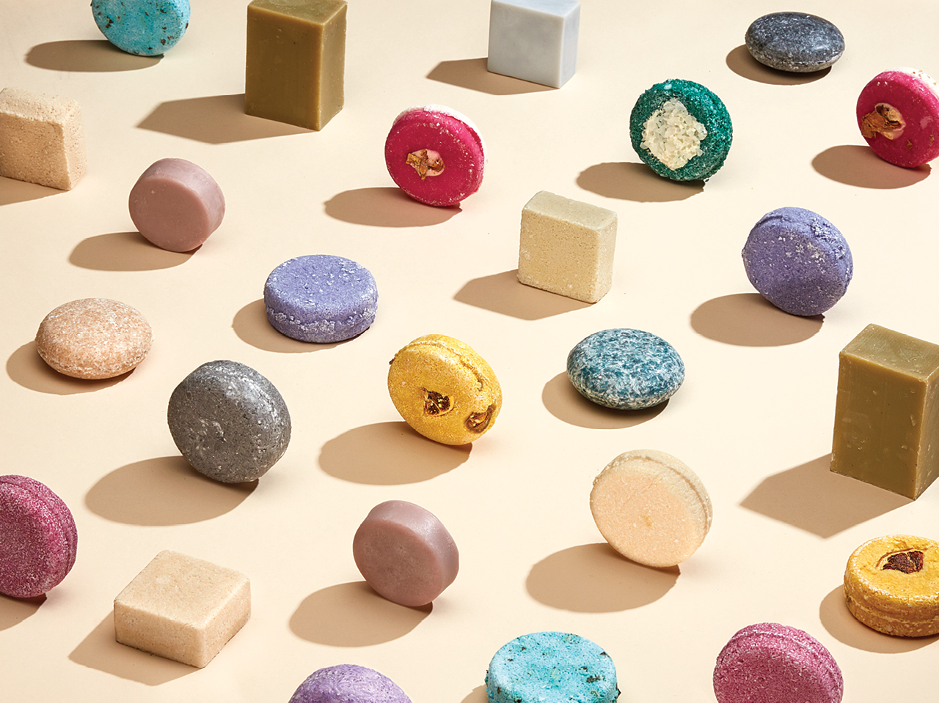
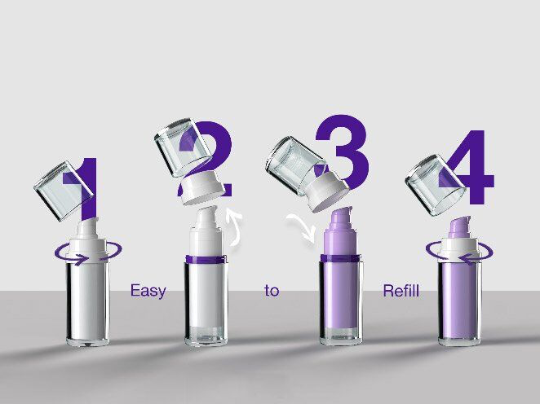
TOP 5 BEAUTY TRENDS
HOW DO THESE TRENDS AFFECT FORMULATORS & PRODUCT DEVELOPMENT?
Zero-waste packaging: There is a growing emphasis on reducing waste in the beauty industry. Brands are adopting sustainable packaging solutions such as refillable containers, biodegradable materials, and packaging made from recycled materials.
PCR (Post Consumer Recycled) content is becoming mandatory at retailers such as Credo Beauty
No bottle manufacturers offering reasonable MOQ or stock packaging selection with PCR content
Reliant on importing large custom MOQ’s from China

Slide 3
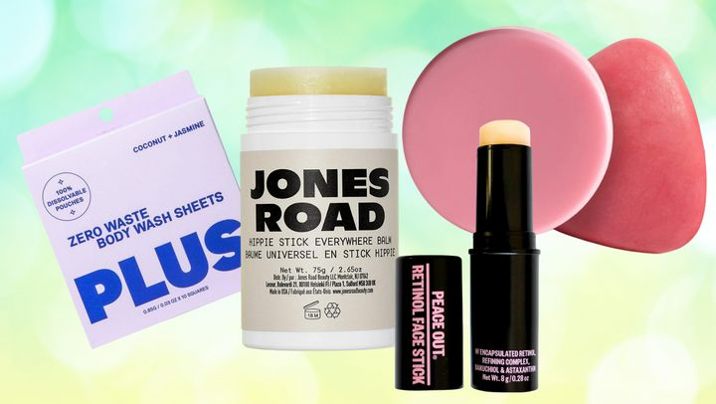
TOP 5 BEAUTY TRENDS
HOW DO THESE TRENDS AFFECT FORMULATORS & PRODUCT DEVELOPMENT?
Water conservation: With increasing concerns about water scarcity, beauty brands are exploring ways to minimize water consumption in their products. Waterless beauty products, such as solid shampoo bars and powder-based skincare, are gaining popularity.
Such a tricky category to develop in Canada as most of the cosmetic oils & esters we use are palm & coconut based and are refined and processed abroad and imported. Cost & carbon footprint is very high.

Slide 4
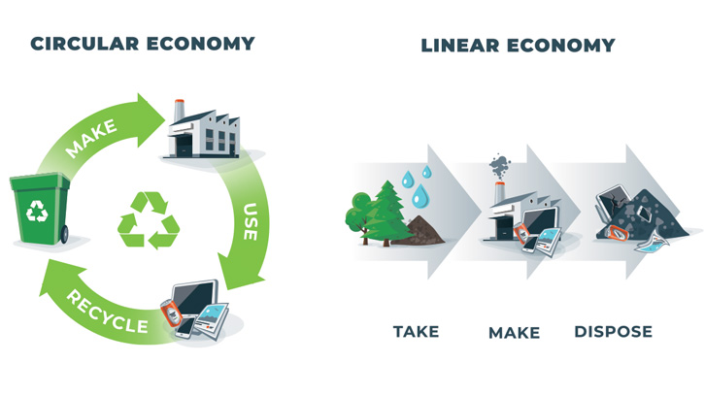
TOP 5 BEAUTY TRENDS
HOW DO THESE TRENDS AFFECT FORMULATORS & PRODUCT DEVELOPMENT?
Upcycling and recycling initiatives: The beauty industry is embracing upcycling and recycling initiatives to reduce waste and promote circularity. Brands are finding creative ways to repurpose by-products, such as using fruit peels in skincare formulations or transforming discarded materials into packaging.
We have so much food and agricultural waste available here in Canada, yet the supplier network for these ingredients is mostly from Europe.
Thankfully, we have new companies here in Canada such as GroundUp Eco-Ventures starting to offer us locally produced upcycled ingredients, but there is still a huge opportunity in the market.
How can we accelerate the development of this category?

Slide 5
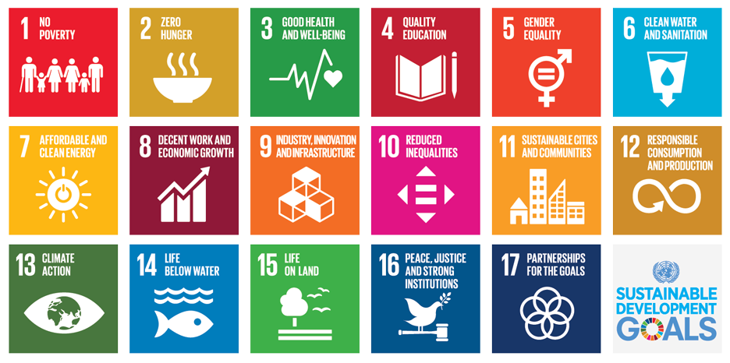
TOP 5 BEAUTY TRENDS HOW DO THESE TRENDS AFFECT FORMULATORS & PRODUCT DEVELOPMENT?
Ethical sourcing and fair trade: Consumers are becoming more conscious of the social and environmental impact of beauty products. They are seeking out brands that prioritize ethically sourced ingredients, support fair trade practices, and promote positive relationships with local communities and farmers. This trend extends to the use of sustainably harvested botanicals and cruelty-free practices.
No options for local ethically sourced ingredients.
Supporting indigenous communities' traditional know-how, Women, POC or LGBTQIA+ led organisations

Slide 6
CASE STUDY
FRANCE’S SUCCESS AS A PIONEER IN NATURAL ORGANIC & SUSTAINABLE BEAUTY
Given The Canadian Cosmetic Cluster’s upcoming mission in France, I wanted to discuss France’s success as a leader and a pioneer in the natural, organic, clean and sustainable beauty categories
France and Canada are not so different; why have they been leading and paving the way and not us?
If we compare what France has as an industry and what Canada is missing, the parallels between what we are struggling with as an industry and what we need to respond to the most important beauty trends are already established in France.
Can France’s success be mimicked in Canada? Can we use it as proof of concept to attract more investment and development of the industry?

Slide 7
COSMETIC SCIENCE
EDUCATION
30+ YEARS
HIGH AVAILABILITY OF LOCAL BRANDS MADE FROM LOCALLY SOURCED INGREDIENTS
RENEWABLE NATURAL RESOURCES
FRANCE
BIO REFINERIES & INDUSTRIAL KNOW-HOW IN EXTRACTION
MANUFACTURING
EXPERTISE &
KNOW-HOW
STABLE LOCAL SUPPLY CHAIN WITH STRONG EXPORTS

Slide 8
COSMETIC SCIENCE
EDUCATION
LESS THAN 10 YEARS
LIMITED SELECTION OF LOCAL BRANDS, VERY LITTLE MADE FROM LOCAL RESOURCES
RENEWABLE NATURAL RESOURCES
CANADA
BIO REFINERIES & INDUSTRIAL KNOW-HOW IN EXTRACTION
MANUFACTURING
EXPERTISE &
KNOW-HOW
VULNERABLE SUPPLY CHAIN DEPENDANT ON IMPORTS

