Slide 1
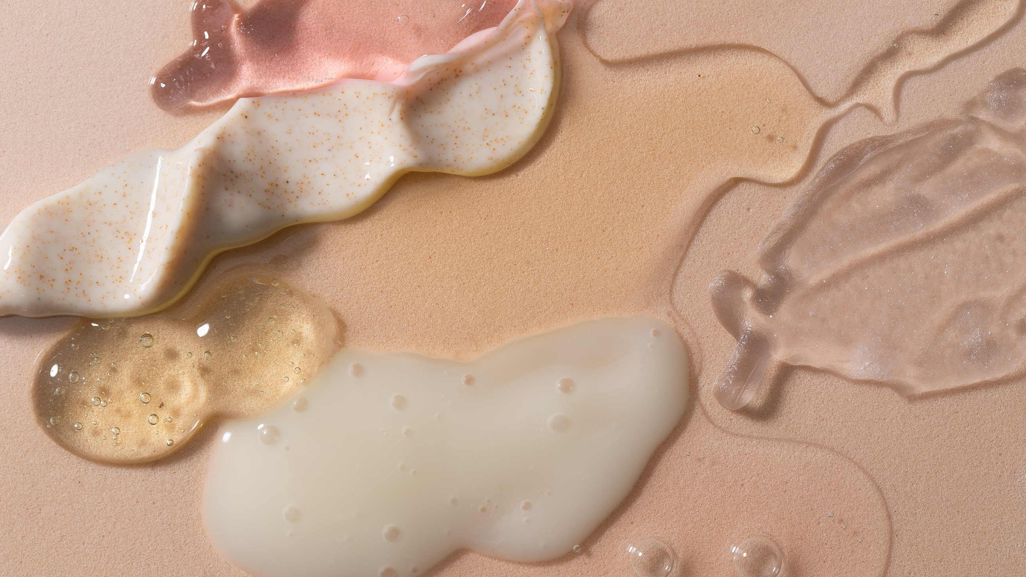

CANADIAN COSMETICS CLUSTER
INNOVATION NIGHT
JANUARY 31, 2023

Slide 3


INNOVATION: TRENDS*
Foundational consumer behaviours centred around sustainability, value, wellbeing and experiences.
*MINTEL 2023 Global Beauty and Personal Care Trends
BEAUTY RX
Beauty Rx : Proof behind claims
Evolved Self-Care : Wellness for every life stage
New Rules : Playfulness, experimentation & DIY
EVOLVED SELF-CARE
NEW RULES
COSMETICS INNOVATION NIGHT JANUARY 31ST, 2023

Slide 4




PRODUCT HIGHLIGHTS
COSMETICS NIGHT OUT SEPTEMBER 15TH, 2022

Slide 5





NEW RULES
ESTOGEL® M
Gels polar to medium polar oils
Leads to very transparent and strong gels
High suspending ability
91% natural derived content
(ISO 16128)
China compliant
Process at 100°C
INCI: Castor Oil/IPDI Copolymer (and) Caprylic/Capric Triglyceride

Slide 6


NEW RULES
ESTOGEL® GREEN
Gels oils with different polarities (polar to apolar)
Leads to very transparent gel that can flow
High suspending ability
100% natural derived content
(ISO 16128)
COSMOS certified
China compliant
Process at 80°C
INCI: Hydrogenated Castor Oil/Sebacic Acid Copolymer
COSMETICS INNOVATION NIGHT JANUARY 31ST, 2023

Slide 7

A timeless secret of​ skin rebirth
Rice starch​​
Sustainable & Transparent
Organically grown​ in EU
Ultra-small and uniform particle size (average 4 μm)
Clinical testing
In Vitro Testing
BEAUTY RX
NEW RULES
GOSULIN RICE
Smooths skin
Mattifies the skin comparable to silica beads
Blurs imperfections away immediately
Cleans the skin more efficiently than surfactants
Removes blackheads ​& unclogs pores​
Gives visible results after just 1 application
INCI: Oryza Sativa Starch​
COSMETICS INNOVATION NIGHT JANUARY 31ST, 2023

Slide 8

BEAUTY RX
EVOLVED SELF-CARE
CALYBIOTA® BIO
Eco-designed active ingredient
Red kapok tree flower polysaccharides (Bombax costatum)plant
Sourced in Burkina Faso
Clinical Testing
In Vitro Testing
Microbiota Balance
Prebiotic effect
Intimate flora Protection
INCI name: Glycerin, Water, Bombax Costatum Flower Extract
COSMETICS NIGHT OUT SEPTEMBER 15TH, 2022

Slide 9

EVOLVED SELF-CARE
BEAUTY RX
SERENE SKIN SAGE
Enhances complexion
Reconstructing, lipid-replenishing
Regenerating
Protection and repair
Balancing
Soothing, anti-inflammatory
Helps skin combat multiple external threats
Provides an active skin barrier
Clinical testing
In Vitro Testing
INCI name of cells: Salvia officinalis callus extract
COSMETICS NIGHT OUT SEPTEMBER 15TH, 2022

Slide 10


